Slide 1
115kV / 34.5kV Solar Power Plant/Substation Design Project
Team sdmay19-26
Tam Nguyen, Nur Shuazlan, Katayi Katanga, Yao Jiang Cheah, Chufu Zhou
Advisor: Dr. Ajjarapu
Client: Black & Veatch
http://sdmay19-26.sd.ece.iastate.edu/
Notes:
Title slide (title, team, advisor, and client info)

Slide 2
Safety Moment: Elevator Safety
Do:
Hold handrail, stay away from door
Use alarm button
Stay calm + Stay stuck in elevator
Don’t:
Use in event of fire
Get on if overcrowded
Engage in horseplay
Rest on/push someone against doors

Slide 3
Black & Veatch Information
A global engineering, construction and consulting company which specializes in infrastructure development for power, oil and gas, water, telecommunications, government, mining, and banking and finance markets.
The largest majority employee-owned company in the U.S, and is ranked by Forbes as one of the largest privately owned companies.
A large amount of its revenues comes from power division.
Notes:
Tam

Slide 4
Problem Statement
Problem:
Provide clean energy for a grid shifting towards renewables to decrease its dependence on fossil fuels
Solution:
Design a 60 MW solar plant that feeds a 115 kV/34.5kV substation
Notes:
Tam

Slide 5
System Design
Notes:
Tam
Problem Statement
Conceptual Sketch
Functional Requirements
Non-functional Requirements
Technical/Other Constraints/Considerations, Market survey – articulate what makes your project unique
Potential Risks & Mitigation , Resource/Cost Estimate , Project Milestones & Schedule

Slide 6
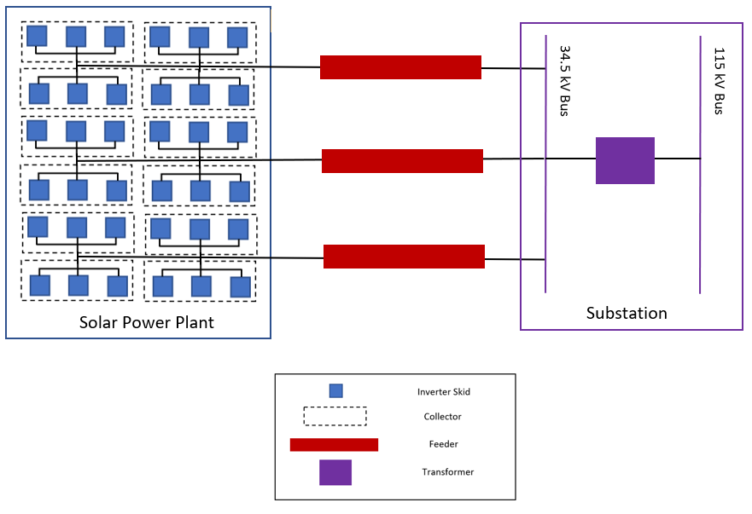
Conceptual Sketch
Notes:
Tam

Slide 7
System Block Diagram
Notes:
Tam
The solar racks consist of 238032 solar panels which generate DC power.
The panels are connected to strings and each string has 19 panels connected to it.
To bring several Solar strings output together and consolidate incoming power into main feed we will be using about 792 CBs.
To convert the combined output voltage from DC to AC the plant will have about 36 inverters and each inverter will be attached to step-up transformer.
We will have three feeders that’s carrying about 409 A each, attached to 34.5 KV bus.
At the end the substation will have another step-up transformer to raise the voltage to 115 KV transmission level.

Slide 8
Functional Requirements
Solar farm parameters
DC Voltage: 1000 V
Inverter: Eaton 1666kW
Panel: Hanwha 325W
ILR: 1.30
Fixed rack system
Project scope document
NEC requirements
IEEE requirements
Notes:
DC Voltage: 1000 V
Inverter: Eaton 1666kW
Panel: Hanwha 325W
ILR: 1.30
Fixed rack system

Slide 9
Non-Functional Requirements
Location
Cost effectiveness
Man-hour budget
Notes:
Tam
Despite the fact that the specifications are specified by Client, we did went through the justification for solar panels, and the types of rack system

Slide 10
Potential Risks and Mitigation
Component defects (high risk)
Test components before use
Notes:
Tam

Slide 11
Detailed Design
Notes:
Chufu

Slide 12
Design Approach
Scout several locations and evaluate them based on requirements
Perform a series of calculations to determine solar parameters
Create layout design of solar power plant based on parameters and ensure design meets NEC requirements
Create substation protection & controls schematics based on project scope document
Perform grounding calculations based on IEEE document
Notes:
Chufu

Slide 13
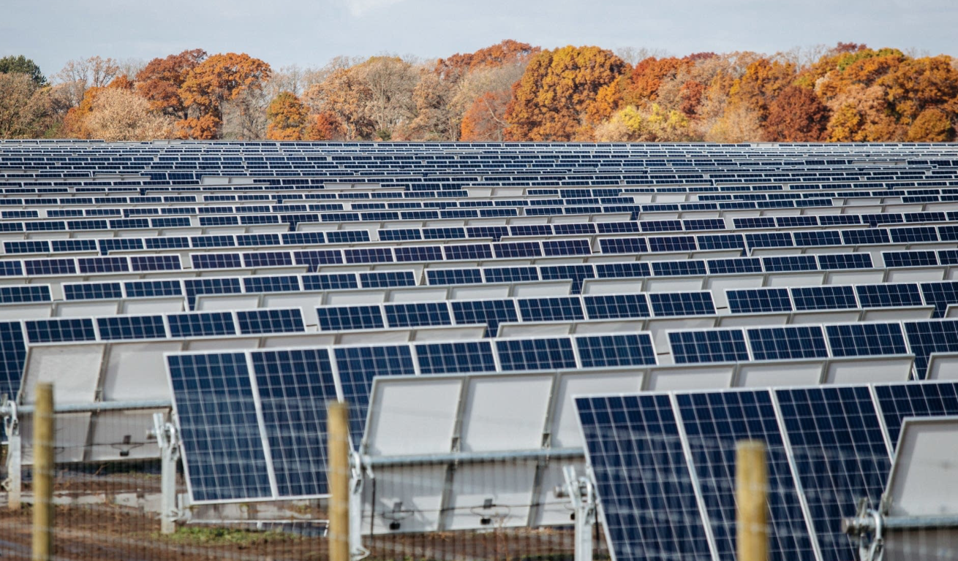
Market and Literature Survey of Similar Projects
MISO North Star Solar Project 100 MW capacity:
Location in Saint Paul, MN
100 MW of solar PV capacity(440,000 solar panels)
Approximately 800 acres of agricultural land
Single axis tracking technology to maximize production
Grid connection at the Chisago County substation 115kV
Notes:
Chufu
Before we started our project we looked at the market for similar projects. Even Though there are alot of solar project in the market, the MISO north star solar project is more similar to our project in term of the power flow generation and the substation.

Slide 14
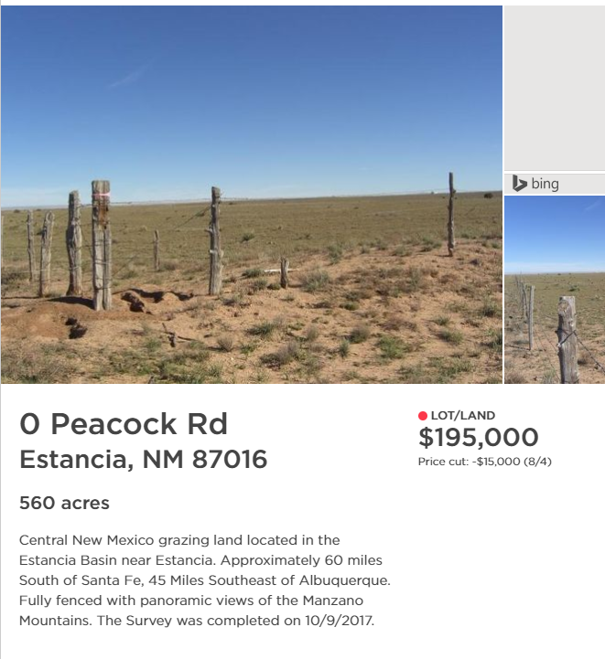
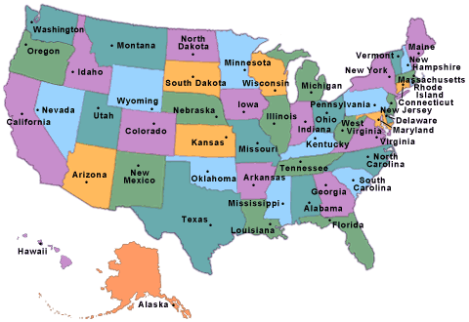
Location Decision
Notes:
Chufu
We chose the location based on 9 factors: Solar radiation, Land size and price, Sunny days per year, Elevation, State financial incentives ranking, Total cost of solar power plant, Extra land for substation and expansion, More cost-effective than the rest of the Nation, and Distance to the nearest city/town.
We compare between 6 locations, and Estancia, NM was the best one.

Slide 15
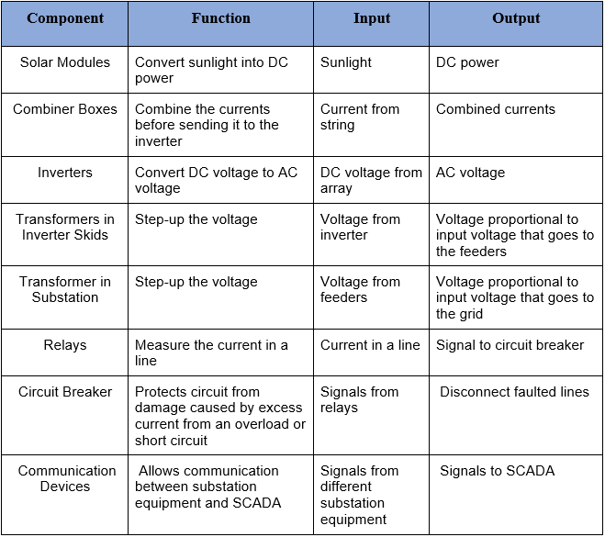
Functional Decomposition
Notes:
Chufu

Slide 16
Resource Requirements
Solar Power Plant
Equipment:
238,032 solar panels
792 combiner boxes
36 inverters
36 step-up transformers
244 acres of land
We found a 560-acre land for sale for $195,000
NEC document
Software:
AutoCAD
Microsoft Excel
NREL SAM
Substation
Equipment:
Circuit breakers
Relays
Rigid bus
Steel + conductors
Concrete foundation
Communication devices
Transformer
IEEE std 80-2000
Software:
AutoCAD
Microsoft Excel
Notes:
Chufu
IEEE Guide for Safety in AC Substation Grounding

Slide 17
System Analysis
Array parameter calculations
Determined number of components and verified the voltage and power of the system
Voltage drop calculations
Carried out conductor sizing by analyzing the currents in the plant at different points
Substation grounding grid calculations
Determined grounding parameters to ensure step/touch voltages were less than the tolerable step/touch
Notes:
Chufu

Slide 18
Phase 1: Solar Plant Design
Notes:
Nur

Slide 19
Single Rack Layout
Based on:
Desired string voltage: 1000 VDC (Actual 972 V)
Voc, Isc of panels
Location min. Temp. to calculate corrected Voc

Slide 20
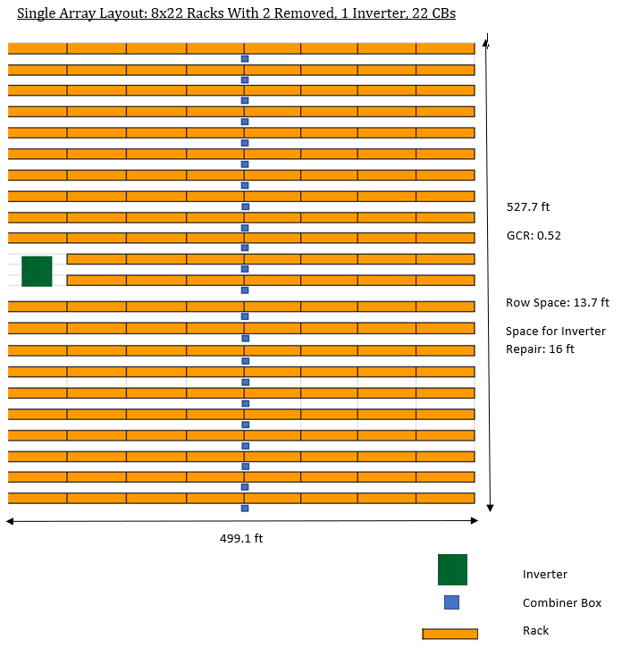
Single Array Layout
Based on:
Single rack layout
Desired ILR of 1.3 (Actual 1.29)
Tilt angle: 29.7 degrees
Sufficient row space to prevent shading losses of solar panels

Slide 21
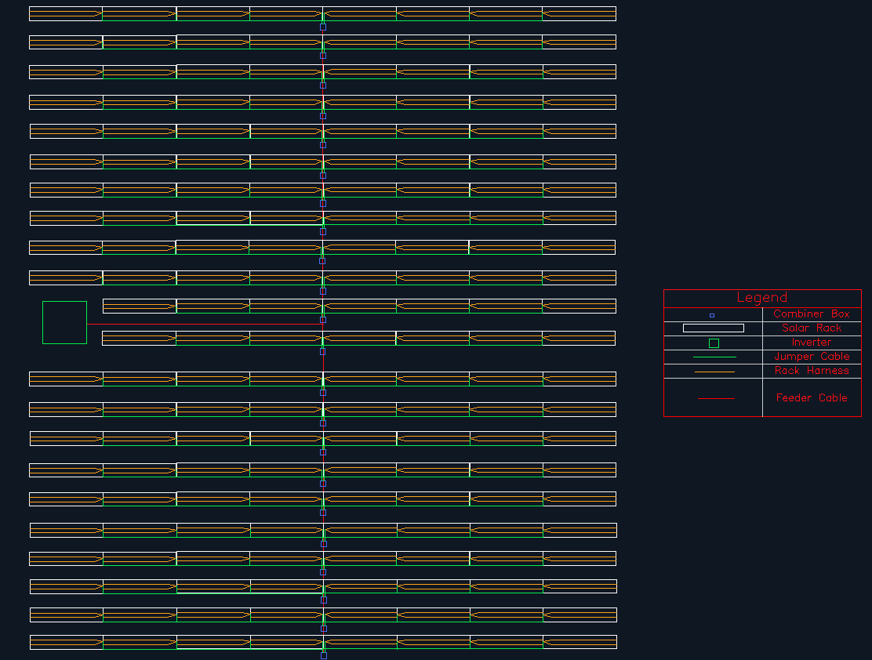
Rack harness: solar panels in a rack
Jumper cables: racks in a row to the combiner boxes
Feeder cables: combiner boxes to the inverter
Notes:
Nur

Slide 22
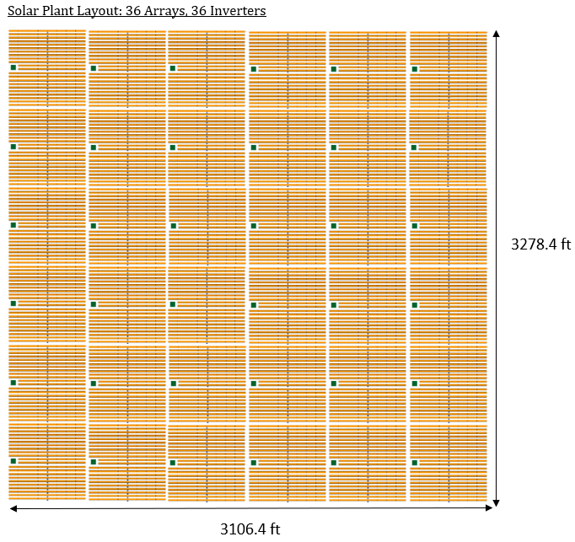
Solar Plant Layout
Consists of 36 arrays in a 6x6 arrangement
16 ft between each array for access roads
Notes:
Nur

Slide 23
Phase 2: Substation Design
Notes:
Nur

Slide 24
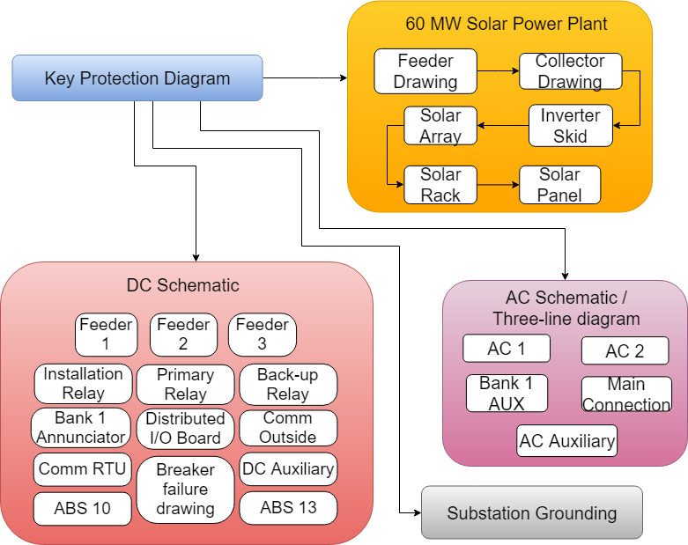
Protection & Controls Drawing Hierarchy
Notes:
Key protection: foundation of our project
By using the key protection diagram, we were able to create the feeder and collector drawings to connect solar plant to the substation
In the beginning of the project, our clients gave us standard protection & controls schematics and we had to edit these drawings based on the single line diagram and project scope document that they gave us. The project scope document tells us how
And we used AutoCAD to edit these drawings.
After we finished the drawings, we designed the grounding grid for the substation.

Slide 25
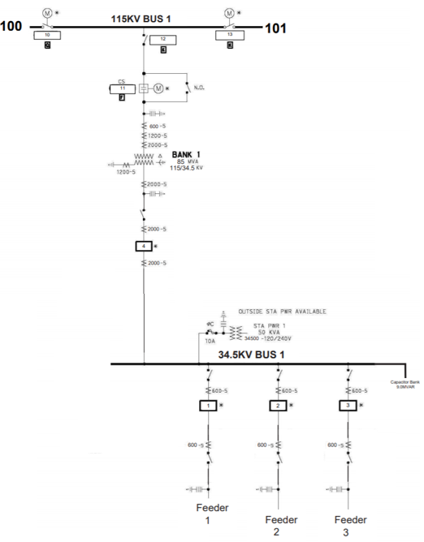
Single Line Diagram

Slide 26
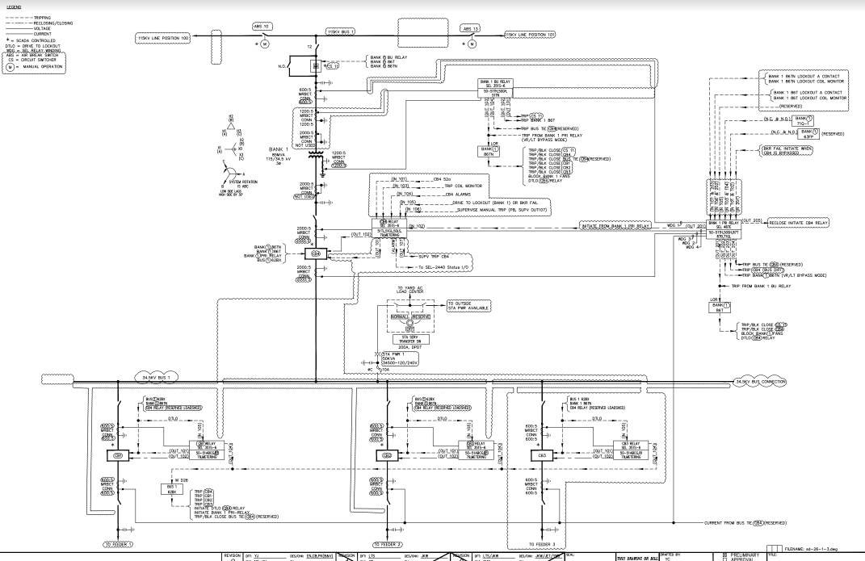
Key Protection Schematic

Slide 27
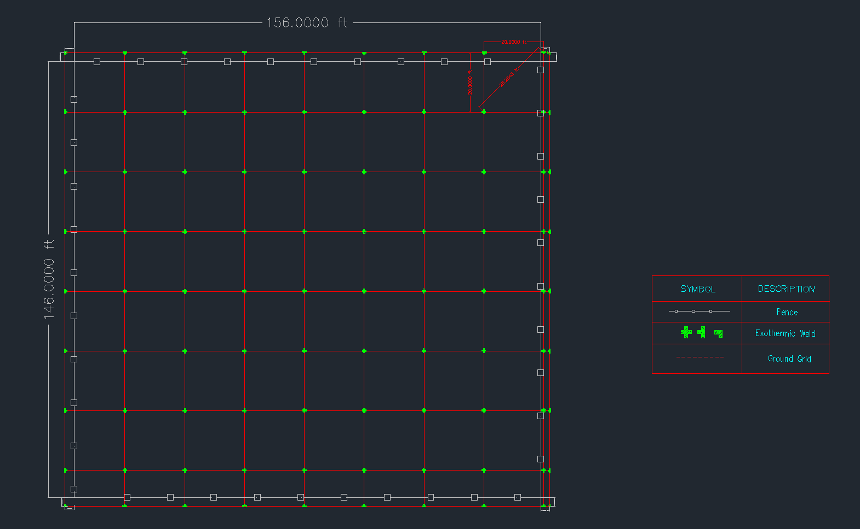
Substation Grounding
Resistivity of soil
Calculate tolerable step and touch voltages
Make sure that the maximum step and touch voltages are less than the tolerable ones
Notes:
Nur

Slide 28
Testing
Notes:
Kat

Slide 29
Testing and Evaluation Plan (Solar Power Plant)
National Renewable Energy Lab System Advisor Model (NREL SAM):
Performance model that takes in solar power plant parameters
Simulates the system
Simulation input parameters:
Location (Based on Latitude and Longitude)
Types of Inverters and Solar Panels we are using
Types of rack system (Fixed or Variable Rack and also Tilt angle and Ground Coverage Ratio)
Number of inverters
Size of panels
Number of solar modules in one string
Simulation output parameters
The number of panels (Check if it matches with our Array Parameter Tool)
Number of strings (Check if it matches with our Array Parameter Tool)
ILR (Check if it matches with our Array Parameter Tool)
Notes:
Kat

Slide 30
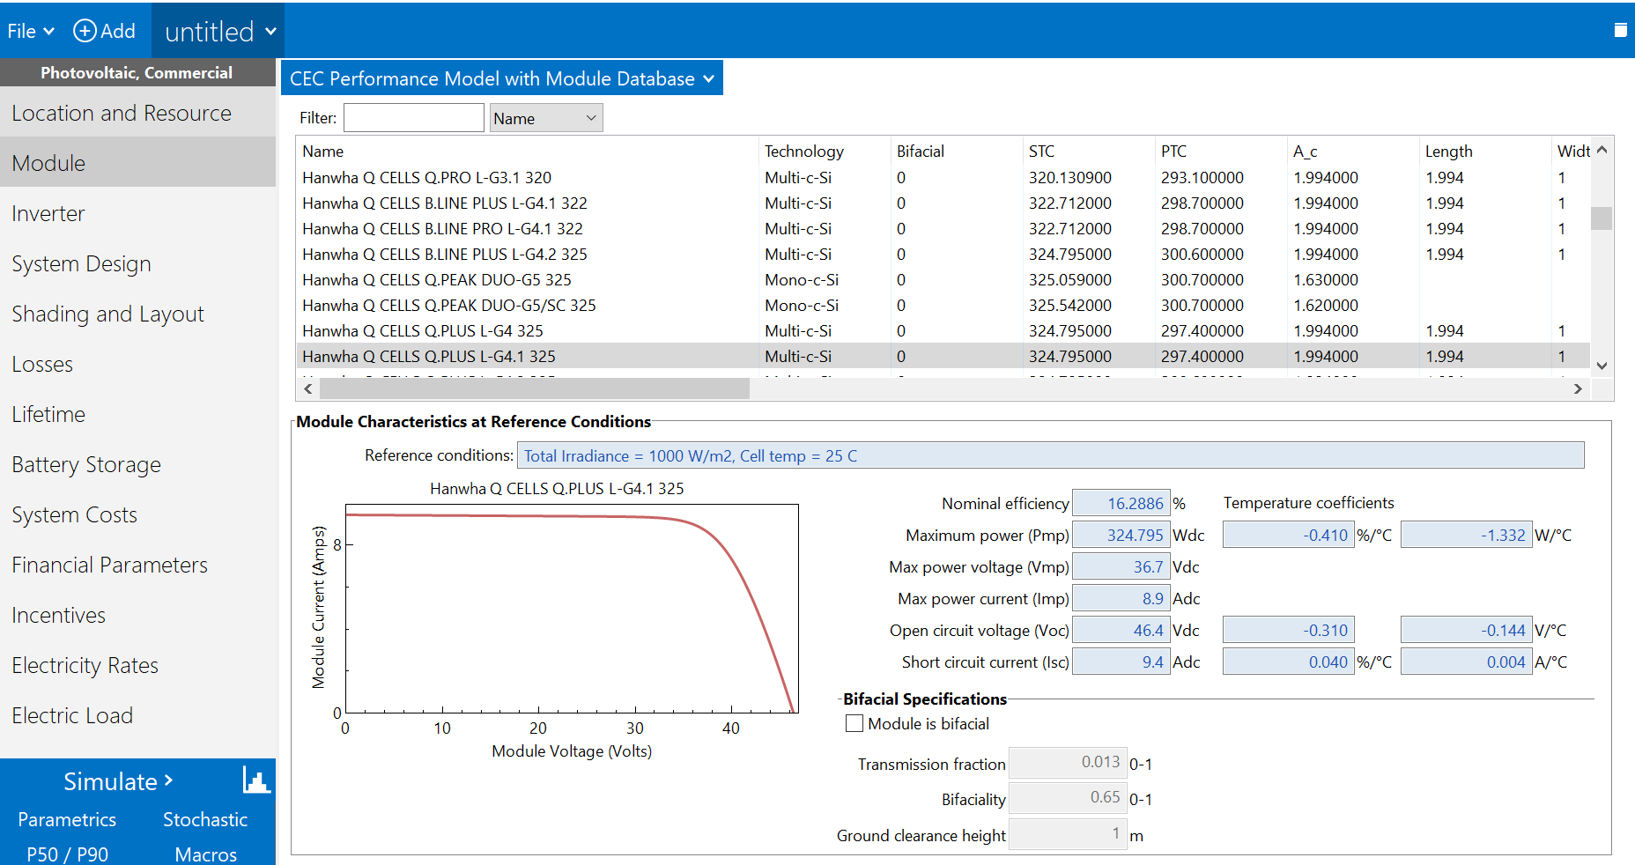
NREL SAM: Sizing Summary
Notes:
Kat

Slide 31
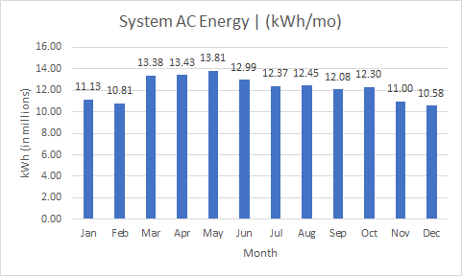
Test Results & Evaluations
Notes:
Kat

Slide 32
Testing and Evaluation Plan (Substation Design)
Compliance with NEC and IEEE codes:
Checking design against the codes specified
Calculating the conductor sizes and the voltage drop according the code.
Notes:
Kat

Slide 33
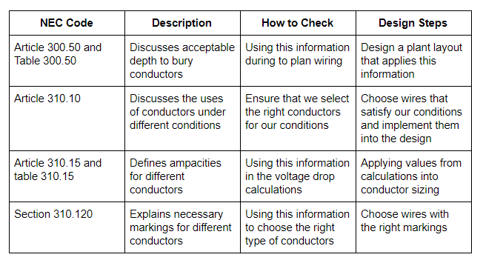
Testing and Evaluation Plan (Solar Plant)
Compliance with the following NEC codes:
Notes:
Kat
Article 300.50, Table 300.50
Direct-Buried Cables under general condition
Voltage over 1000V through 22kV
750mm or 30inches underground for solar power plant
Voltage over 22kV through 40kV
900mm or 36inches underground for feeder line and up to the lowside of substation design that has 34.5kV
Voltage over 40kV
1000mm or 42inches underground, will be on highside of substation design

Slide 34
Testing and Evaluation Plan (Substation)
Compliance with IEEE 80-2000 Equations and assumptions:
Assuming that the rod length is 20ft
Notes:
Kat
Article 300.50, Table 300.50
Direct-Buried Cables under general condition
Voltage over 1000V through 22kV
750mm or 30inches underground for solar power plant
Voltage over 22kV through 40kV
900mm or 36inches underground for feeder line and up to the lowside of substation design that has 34.5kV
Voltage over 40kV
1000mm or 42inches underground, will be on highside of substation design

Slide 35
Deliverables
Notes:
YJ

Slide 36
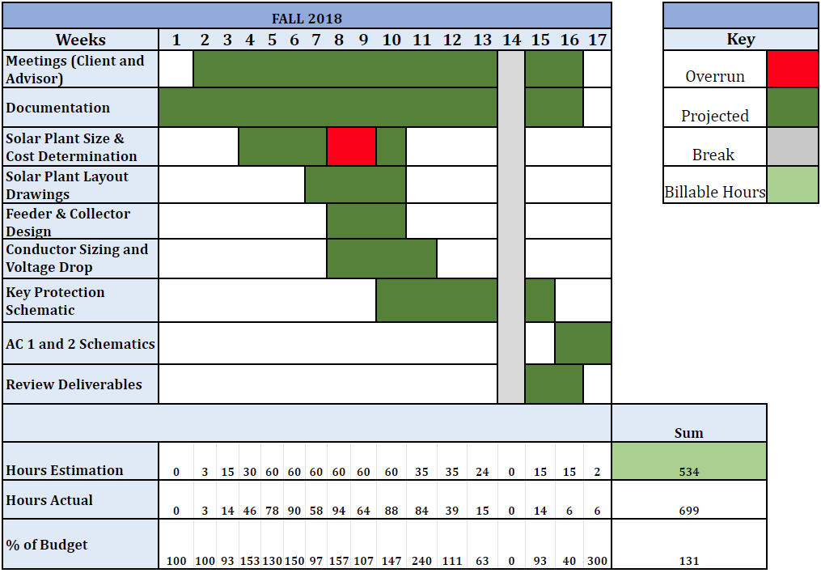
Man Hour Budget: Fall 2018
Notes:
YJ

Slide 37
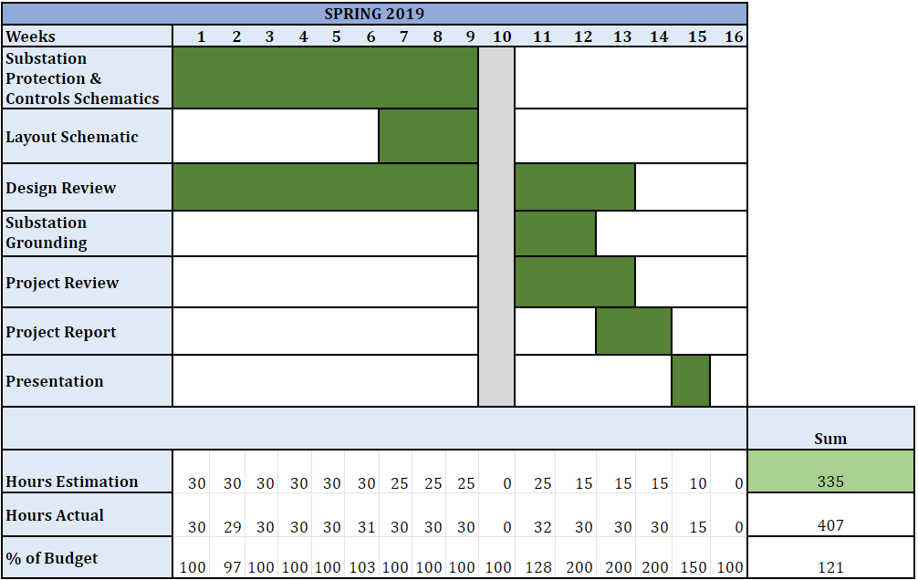
Man Hour Budget: Spring 2019
Notes:
YJ

Slide 38
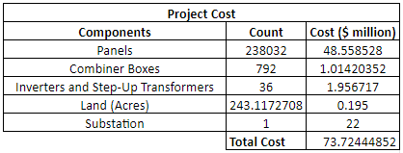
Cost of Project
Notes:
YJ

Slide 39
Challenges Faced and Solutions
Lack of solar parameter knowledge
Voltage Drop Calculations
MPP
Protection and Controls design (AutoCAD)
Client and advisor feedback
Learned how to use AutoCAD
Notes:
YJ

Slide 40
Project Success
Submitted all deliverables on time with satisfaction from client
Learned a lot about solar power plant and substation design
If implemented, project would decrease the grid’s dependence on fossil fuels
Notes:
YJ

Slide 41
Future Work
Adoption of project
Notes:
YJ

Slide 42
Conclusion & Lesson Learned
Design process and documentation
Importance of NEC and IEEE codes
Notes:
YJ

Slide 43
Thank You For Listening!
Any Questions?

Slide 44
Work Cited
Irish Solar Energy Association. [Online]. Available: http://irishsolarenergy.org/solar-energy.
Power Xpert Solar 1500/1650 kW Inverters. [Online]. Available: https://www.eaton.com/SEAsia/ProductsSolutions/Electrical/ProductsServices/PowerDistributionComponents/SolarSwitchesInverters/S1500_1650/index.htm.
“Atonix Digital using predictive analytics to tackle Black &amp; Veatch first, then world,” Startland News, 15-Feb-2019. [Online]. Available: https://www.startlandnews.com/2019/02/atonix-digital-black-veatch.
“Black &amp; Veatch,” Black &amp; Veatch. [Online]. Available: https://www.bv.com/.
“Hanwha Q CELLS,” Hanwha Q CELLS. [Online]. Available: https://www.hanwha-qcells.com/.
Kronsbein, “Hungary's largest solar power plant is now operational,” Sun &amp; Wind Energy, 23-Oct-2015. [Online]. Available: http://www.sunwindenergy.com/photovoltaics/hungarys-largest-solar-power-plant-now-operational.
SolarBOS, “Disconnect Combiners,” SolarBOS, 01-Jan-1970. [Online]. Available: http://www.solarbos.com/Disconnect-Combiners.
Notes:
Image Cite:
http://irishsolarenergy.org/solar-energy
https://www.startlandnews.com/2019/02/atonix-digital-black-veatch/
https://www.bv.com/
http://www.sunwindenergy.com/photovoltaics/hungarys-largest-solar-power-plant-now-operational

